Slide 1


Office Ergonomics

Slide 2

About This Module
Welcome
Overview
Learning Objectives
Welcome to BLR training. Be sure to ask your supervisor if you do not understand any of the information presented in the program.

Slide 3
About This Module
Welcome
Overview
Learning Objectives
MSDs (musculoskeletal disorders) are among the most frequently reported causes of lost or restricted work time. Workers in many different industries and occupations can be exposed to MSD risk factors at work. Fortunately, work-related MSDs can be prevented.

Slide 4
About This Module
Welcome
Overview
Learning Objectives
At the completion of this module, the participant will be able to:
  Recognize the importance of ergonomics
  Define MSDs
  Identify ergonomic risk factors
  Recognize MSD symptoms
  Set up your workstation to minimize stress and strain
  Perform tasks safely, and avoid musculoskeletal injuries and illness

Slide 5
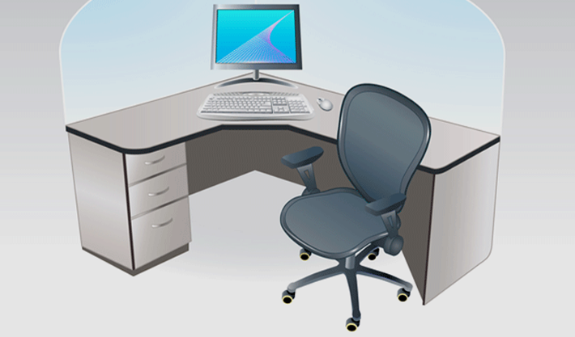

What Is Ergonomics, and Why Is It Important to You?
Reduce injuries and illness
Engineering and administrative controls

Slide 6
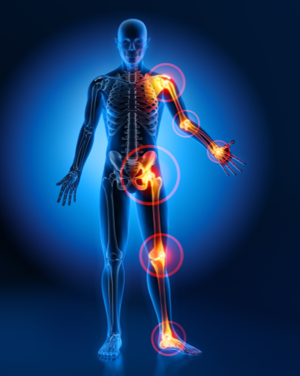
What Are MSDs?
Injuries or disorders involving:
Muscles
Tendons and ligaments
Joints
Cartilage
Blood vessels
Nerves

Slide 7

What Are the Risk Factors?
Repetition
Awkward postures
Contact stress
Force and vibration

Slide 8

What Are the Signs and Symptoms of MSDs?

Slide 9
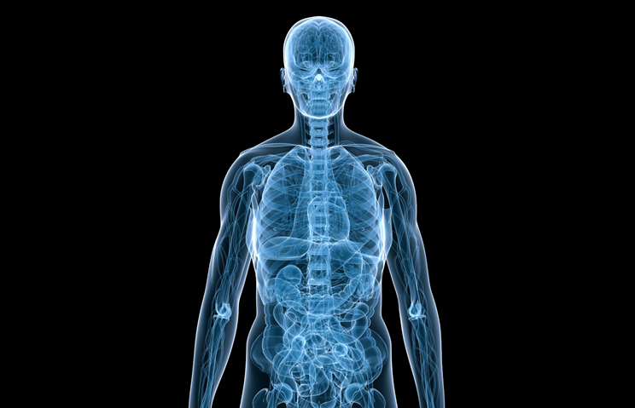
What Will the Pain Be Like?
Tightness
Stiffness
Discomfort
Soreness
Burning
Tingling
Coldness
Numbness

Slide 10
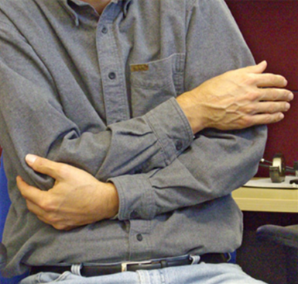
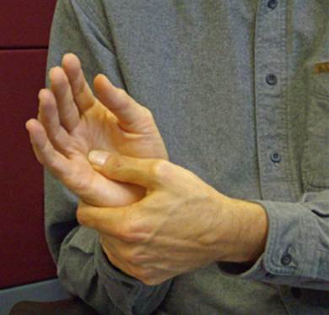
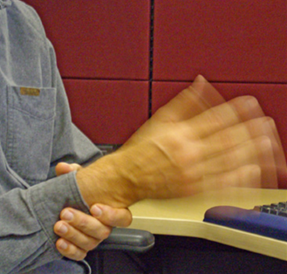
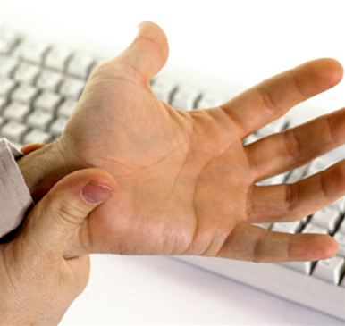
Are There Any Outward Signs?
Swollen or inflamed joints
Vigorous shaking of hands and wrists
Massaging of hands, wrists, or arms
Cradling of arms

Slide 11
What Are Some of the Most Common MSDs?
Carpal Tunnel Syndrome
Tendinitis
Tenosynovitis
Thoracic Outlet Syndrome
De Quervain’s Disease
Trigger Finger

Slide 12
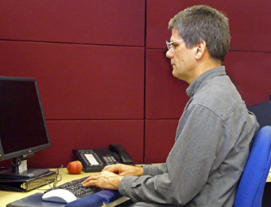
Computer Workstation: Head and Shoulders
Head vertical and facing forward
Tilted head puts stress on neck and shoulders
Minimize head rotation
Shoulders relaxed
Arms tucked close to body
No extended reaching

Slide 13

Computer Workstation: Elbows and Wrists
Elbows relaxed and close to the body
Elbows not extended forward or backward
Wrists in a straight line with lower arms
Hands not flexed up or down or bent inward or outward

Slide 14
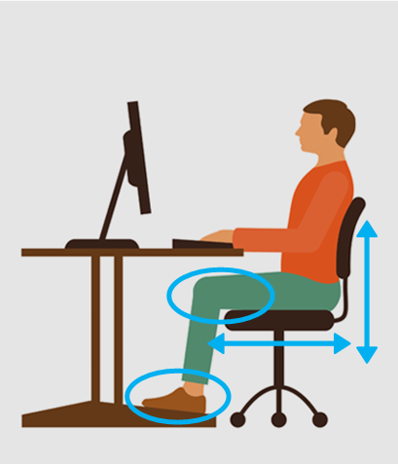
Computer Workstation: Legs and Feet
Knees bent about 90 degrees
Thighs parallel to floor
Chair at a comfortable height
Obstructions removed
Feet flat on the floor or on a footrest

Slide 15
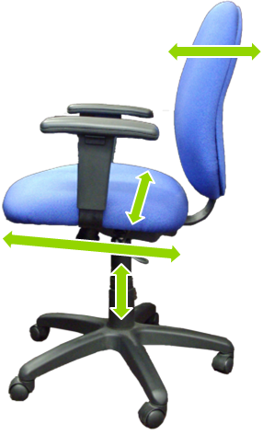
Chair Adjustments: Seat Surface
Comfortable
Slightly wider than hips/thighs
Proper length
Adjustable height
Adjustable tilt

Slide 16
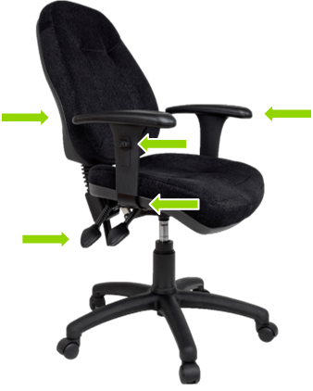
Chair Adjustments: Back and Arms
Backrest with adjustable angle and lumbar support
Armrest broad and cushioned to support shoulders, elbows, and wrists
Armrests independently adjustable in height and side to side

Slide 17
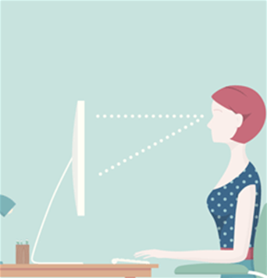
Computer Monitor
Directly in front of you
Arm’s length away
Proper height so head is level
Documents placed close to monitor

Slide 18

Neutral Keyboard Position
Elbows close to body and bent about 90 degrees
Wrists flat and in line with forearms
Hands not angled up/down or turned in/out
No wrist rest when typing

Slide 19

Using a Mouse
Control mouse movement from the elbow
Keep wrist straight in neutral position
Position the mouse properly
Switch mouse to other side if you feel stress

Slide 20

Using a Laptop
Occasional users
  Sacrifice neck posture rather than
  wrist posture
  Sit back in a comfortable chair and adjust laptop
Full-time users
  Position screen like workstation monitor
  Use separate keyboard and mouse

Slide 21

Break Time
Minibreak:
Relax your hands
Rest break:
Do a different task
Eye break:
Look away and blink

Slide 22

Exercises
Hands
Finger extensions
Wrists
Backward stretch
Shoulders
Shrug and roll
Blade pinch
Overhead reach

Slide 23

Exercises (cont.)
Neck
Nod head
Turn head
Tilt head
Back/arms
Hands behind head
Bend forward
Knee to chest
Back bend

Slide 24
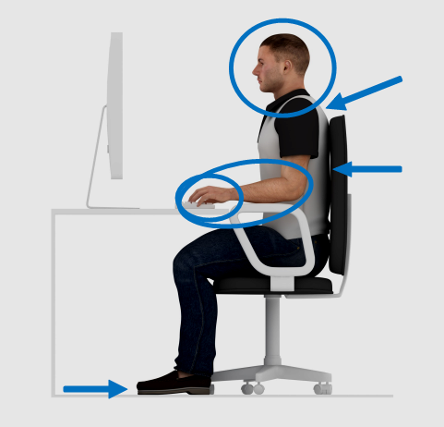
Focus on Your Posture
Elbows at sides, forearms parallel to floor
Wrists in neutral position
Good back support
Feet flat on floor Head and neck facing forward and straight
Relax shoulders

Slide 25

Key Points to Remember
Ergonomics fits task to worker to reduce injuries
MSDs are disorders of nervous system, soft tissue
Risk factors: repetition, awkward postures, contact stress
Most common symptom is pain or swelling
Set up your workstation to minimize strain
Perform tasks safely by using correct posture

