Slide 1
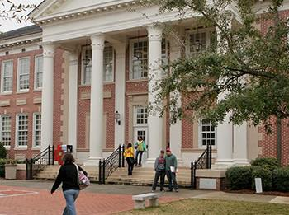
Residence life
Safety Training

Slide 2

purpose
Understand the appropriate safety measures and who to contact in an event of an emergency
Aid in the safety of students in your designated building

Slide 3
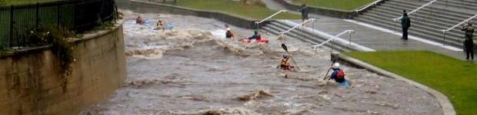
Snow, ice, or flooding
Severe weather / natural hazards
Everyone will be notified by Roadrunner Alert of what to do through campus notifications and news releases
Public Safety will continually monitor weather, news, and road conditions

Slide 4

Earthquake
During Shaking:
Seek refuge in a doorway or under a desk or table
Stay away from glass windows, shelves, and heavy equipment
Do not run through or near buildings
After Shaking:
Evaluate the situation and determine if emergency help is necessary. If so, call DSC Public Safety (706-272-4461) or 911.
Report damaged facilities to Residence Life Director

Slide 5

Tornadoes & thunderstorms
Watch: possibility of one or more tornadoes/storms in the area. Continue with normal activity but monitor weather.
Warning: a tornado/storm has been sighted and may be approaching. Seek shelter immediately.
Seek shelter in the lowest level of the building
Get under a heavy desk or sit next to the wall and cover your head with your arms/hands

Slide 6
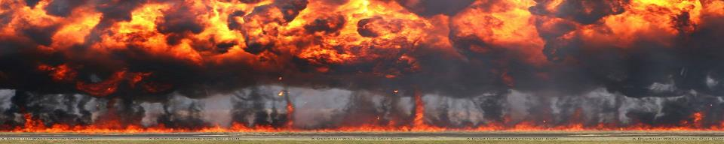
Bomb threats
DO NOT HANDLE the object you observe as a suspicious object or potential bomb
Clear the area immediately and call DSC Public Safety (706) 272-4461 or 911
DSC Public Safety will notify everyone if your building is to be evacuated
  If your building is evacuated:
  Follow evacuation protocols and direction
    Move at least 200ft away from building
  Once outside, stay away from buildings, vehicles, and trash containers
  Police will lead search of the area

Slide 7

Fires
Report to DSC Public Safety (706) 272-4461 or 911
Minor Fires:
Discharge fire extinguisher toward base of the flame
Large Fires:
Activate building alarm and evacuate
Direct crowds away from fire hydrants and road ways – clear sidewalks
Ask bystanders to watch windows for trapped persons
DO NOT attempt to rescue anyone. Notify fire department personnel.

Slide 8
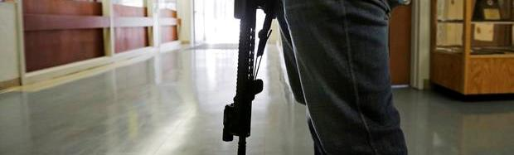
Active shooters
Immediate life-threatening event:
Notify DSC Public Safety (706) 272-4461 or call 911
Each individual should take whatever actions necessary to protect his or her own life
If possible, flee the area safely and avoid danger
      Lock or barricade all doors
Remain in place until “all clear” is given by law enforcement
Someone observed a weapon on campus:
Remain calm and call DSC Public Safety (706) 272-4461
Do not touch the weapon or approach the individual
If possible, remove yourself from area

Slide 9

evacuation
When exiting:
Assist disabled persons in exiting the building
Do not use elevators
Leave streets and walkways clear for emergency vehicles and personnel
Do not return to building unless told to by DSC officials
Entire campus evacuation will be announced by DSC Public Safety

Slide 10
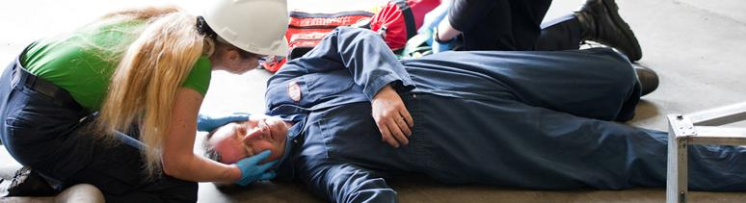
First aid
Remain calm and assess the situation
Do not put yourself in danger
Medical Emergency:
Contact DSC Public Safety (706) 272-4461 or 911
Do not move injured person unless they are in immediate danger of further injury
Check breathing & initiate first aid – do not touch individual without personal protection if there is danger of coming into contact with bodily fluids
Only perform CPR if certified
Minor Injury:
Utilize items in the nearest first aid kit
Instruct individual to consult with their doctor or Health Services

Slide 11
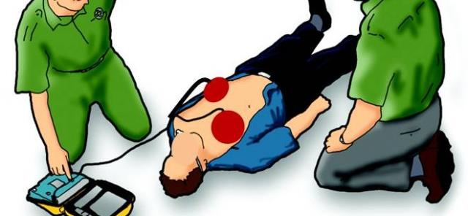
Automated external defibrillator (AED)
An AED is located in the front entrance to Mashburn Hall
The AED will give you step-by-step voice prompts to follow
Immediately summon bystander to notify DSC Public Safety

Slide 12

contact info
DSC Public Safety 24/7 (706) 272-4461
Local Fire, EMS, Police 911

Slide 13

Helpful Links
DSC Emergency Plan
What to do in an Emergency

